Slide 1
Michigan Saves: Financing Energy Improvements for Homeowners, Businesses, and Local Governments
Todd O’Grady, Program Coordinator

Slide 2
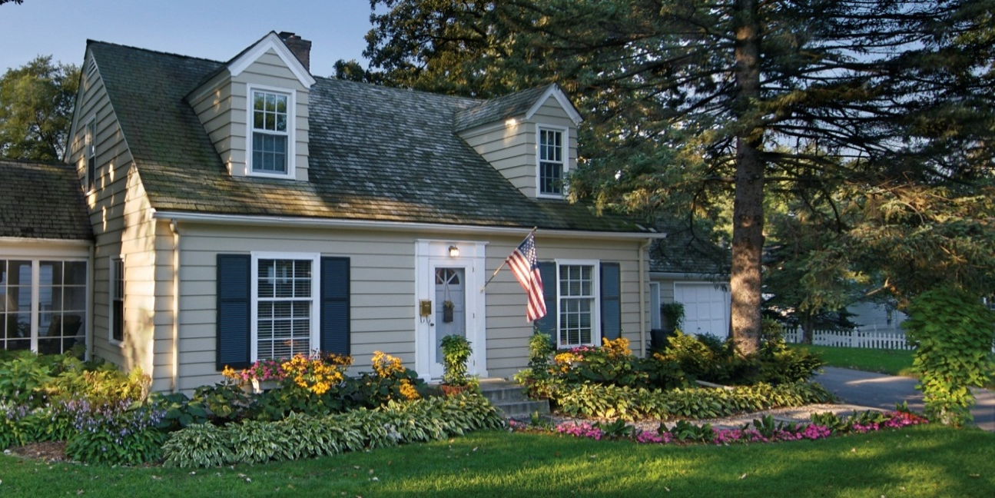
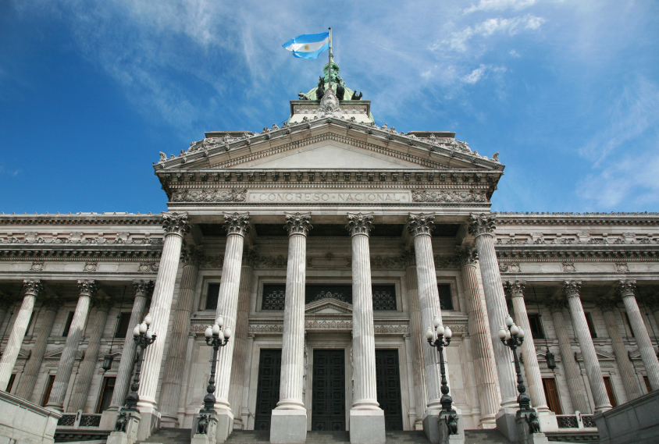
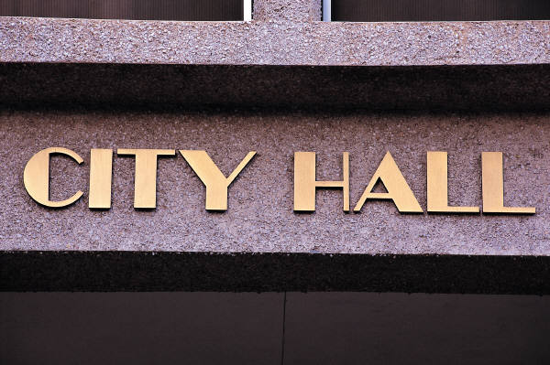
What Is Michigan Saves?
Residential Municipal Business
Notes:
Affordable financing for energy-efficiency and renewable energy – remove first cost barrier
For businesses and homeowners statewide
Municipal financing under development
Nonprofit organization
Public private partnership
Seed funding from state and US DOE
Sustainable model to continue and grow program

Slide 3
Structure
Key Michigan Saves roles:
Provide loss reserve for participating lenders
Oversee authorized contractors
Drive demand for energy efficiency (outreach and incentives)
Set program guidelines and provide quality control
Notes:
5% loss reserve leverages state dollars 20:1

Slide 4
Current programs
Notes:
Also developing muni program
Focus today on home and business financing programs – betterbuildings is in third year

Slide 5
Michigan Saves Home Energy Loan Program
Affordable, hassle-free loans
Easier than home equity – unsecured loan
$1,000 to $20,000
Affordable rates and terms for low monthly payment
Easy, quick approval over the phone or online
Energy efficiency, solar, and geothermal
Find Michigan Saves authorized contractors – www.MichiganSaves.org
Notes:
Program launched in late September 2010
5% loss reserve leverages state dollars 20:1
1.99 percent contractor fee to sustain operations and quality assurance
Over 300 authorized contractors – majority have third-party certification in their trade (HVAC, auditors, etc.)

Slide 6
Participating Lenders
Eight lenders provide statewide coverage
Michigan Saves provides 5% loss reserve
Notes:
Eight participating lenders (currently all credit unions) that collectively provide statewide coverage with some overlapping areas: Lake Trust, Central Macomb Community CU, Financial Plus, LAFCU, MSU FCU, Genysis, UP State, and Great Niles Community Credit Union, Consumers Credit Union

Slide 7
Residential Loans Issued
Loan value: | $16.5 million (of $68 million committed)
Loan loss reserve committed: | $695,667 (of $3.4 million committed)
Loan defaults: | 2 loans (out of 2,037 issued or < 0.1%)
Notes:
Current loan value for the HELP program, including both BBFM and regular 7% loans. The loan value accumulates quickly. The program had more than 2,000/ $16.5 million in loans issued through the end of November. Throughout 2012, Michigan Saves has been averaging 124 home loans per month, and has been adding value at an average rate of about $1,000,000.
Avg. size ~ $8000

Slide 8
Business Energy Financing
Statewide commercial financing ($2,000–$150,000) for energy efficiency improvements through local lender, Ervin Leasing
Available to all types of businesses with focus on food industry
Fast, easy process
Below-market rates with flexible terms up to 5 years
Notes:
One page credit application; decision within 2 days…

Slide 9
Typical Improvements
Special offer!
$2,000 rebate for 20% energy savings for businesses in food industry
Lighting
HVAC
Refrigeration
Kitchen / cooking equipment
Controls and preventive maintenance
Photograph by Marvin Shaouni
Notes:
$2,000 paid by Michigan Saves to business owner when job complete; can use to offset cost of audit or other costs
Michigan Saves marketing through food trade associations and other partners

Slide 10
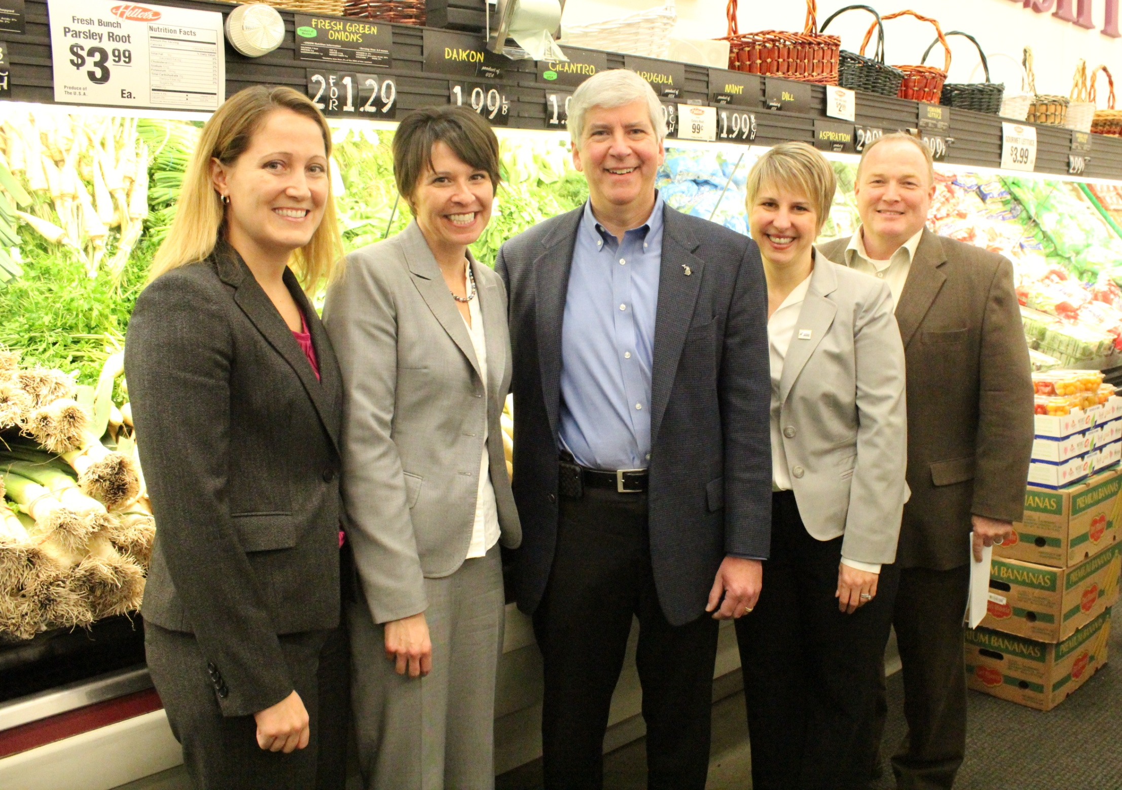
From left to right: Terri Schroeder, Sally Talberg, Gov. Rick Snyder, Julie Metty Bennett, and Todd O’Grady.

Slide 11
Resources and Contacts
Todd O’Grady, togrady@michigansaves.org
Phone (general): (734) 494-2190
Websites: www.michigansaves.org www.betterbuildingsformichigan.org
Email: info@michigansaves.org
Notes:
Conducting evaluation of BB + developing tool kit that can be used by utilities and other program administators, as well as nonprofits to do their own sweeps

